Slide 1
Policy Gradient Methods

Slide 2
Outline
Introduction
Value Based Methods
Policy Based Methods
Policy Gradient
REINFORCE

Slide 3
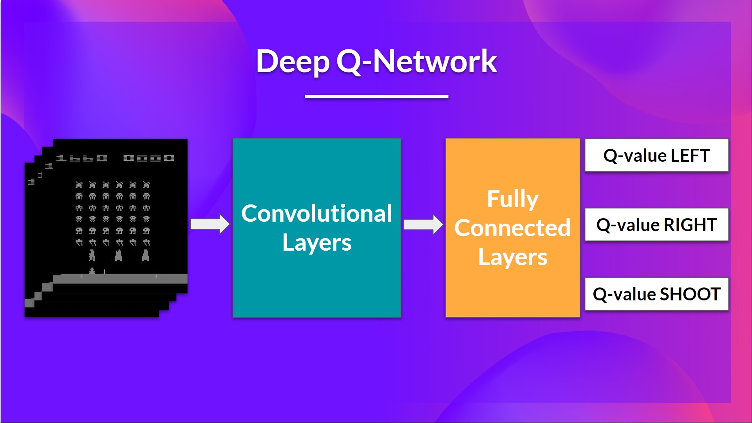
Recap: Deep Q-Learning
In the last lecture, we learned about Deep Q-Learning.
In this value-based deep reinforcement learning algorithm, we used a deep neural network to approximate the different Q-values for each possible action at a state.

Slide 4
Recap: Deep Q-Learning
Up to this point, we have only studied value-based methods, where we estimate a value function as an intermediate step towards finding an optimal policy.

Slide 5
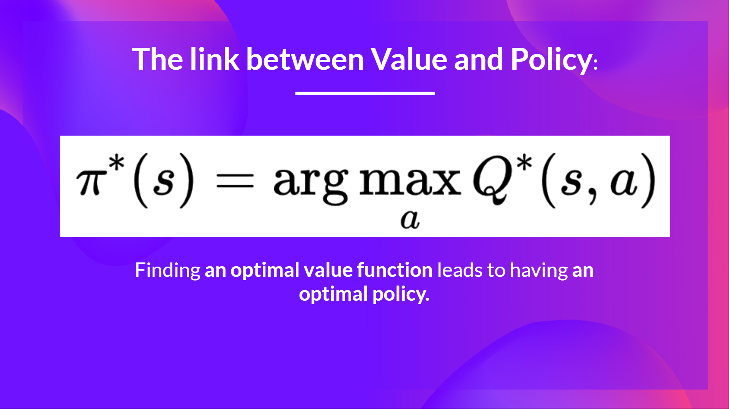
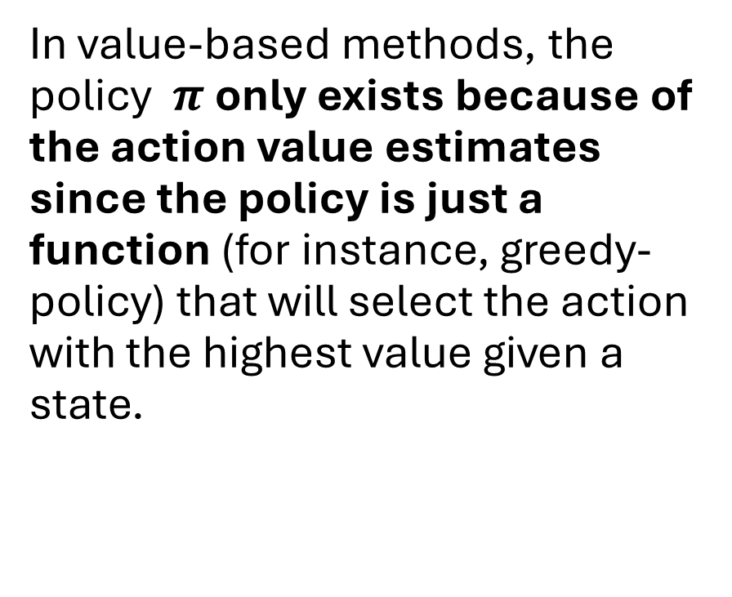
Value-based vs Policy-based
In value-based methods, the policy $π$ only exists because of the action value estimates since the policy is just a function (for instance, greedy-policy) that will select the action with the highest value given a state.

Slide 6
Value-based vs Policy-based
With policy-based methods, we want to optimize the policy directly without having an intermediate step of learning a value function.
So today, we’ll learn about policy-based methods and study a subset of these methods called policy gradient.

Slide 7
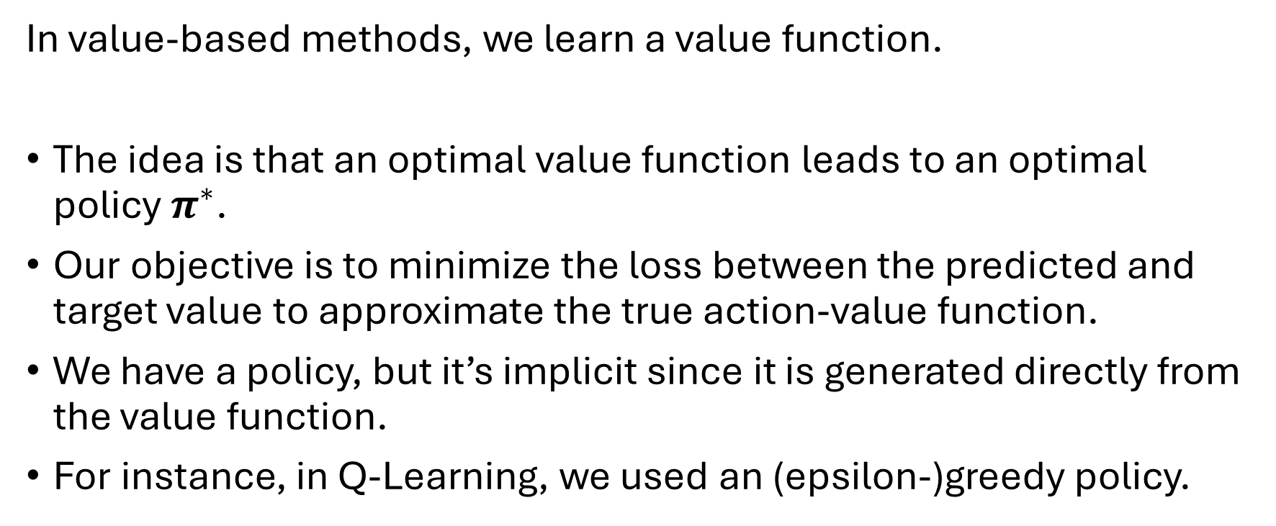
Value-based methods
In value-based methods, we learn a value function.
The idea is that an optimal value function leads to an optimal policy $π^{∗}$.
Our objective is to minimize the loss between the predicted and target value to approximate the true action-value function.
We have a policy, but it’s implicit since it is generated directly from the value function.
For instance, in Q-Learning, we used an (epsilon-)greedy policy.

Slide 8
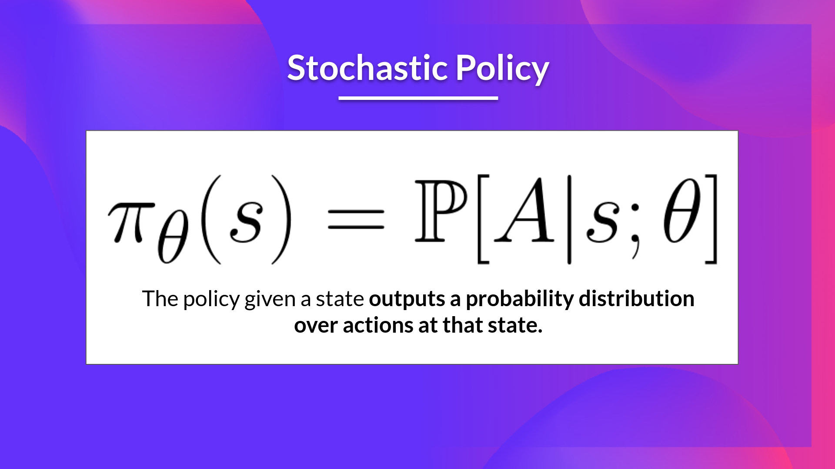
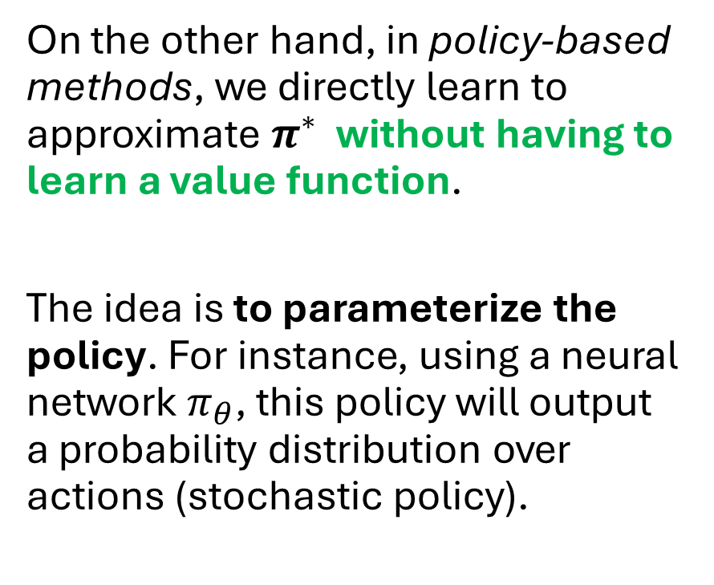
Policy-based methods
On the other hand, in policy-based methods, we directly learn to approximate $π^{∗}$ without having to learn a value function.
The idea is to parameterize the policy. For instance, using a neural network $π_{θ}$​, this policy will output a probability distribution over actions (stochastic policy).

Slide 9
Policy-based methods
Our objective then is to maximize the performance of the parameterized policy using gradient ascent.

Slide 10
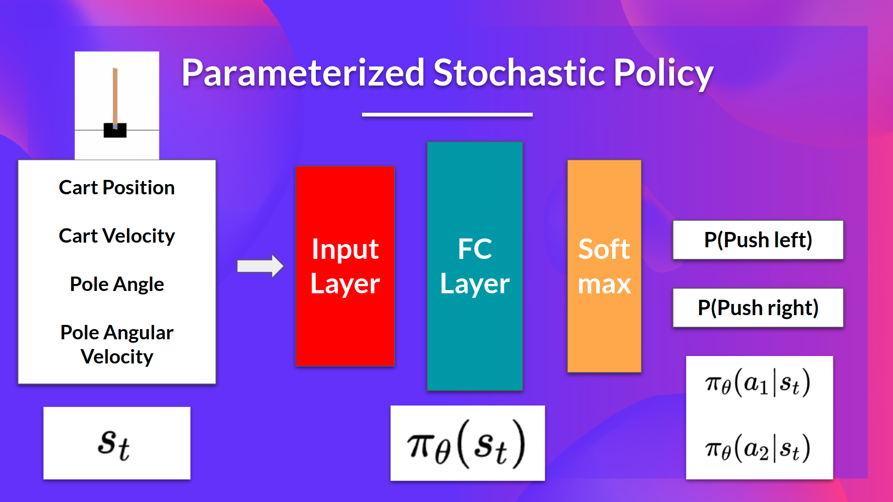

Policy-based methods
To do that, we control the parameter $θ$ that will affect the distribution of actions over a state.

Slide 11
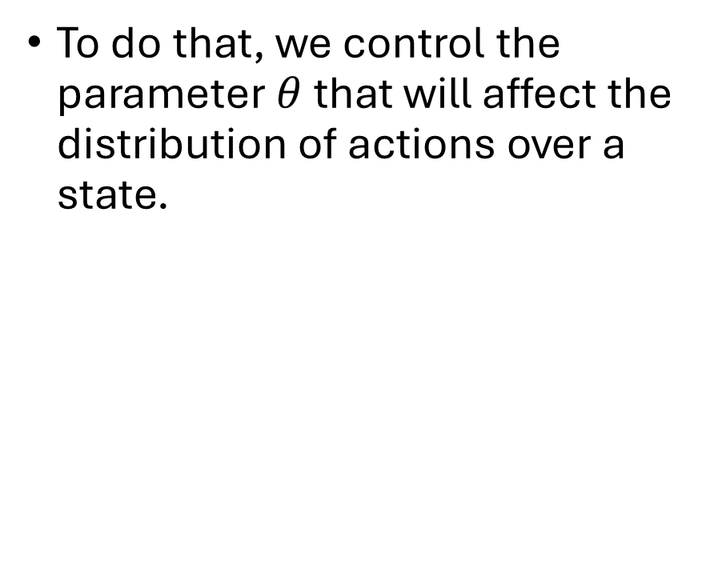
Policy-based methods
To do that, we control the parameter $θ$ that will affect the distribution of actions over a state.

Slide 12
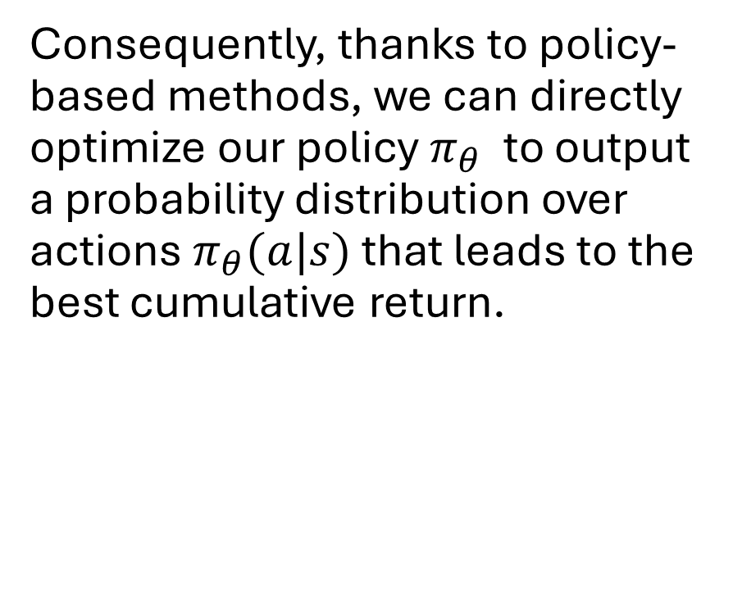
Policy-based methods
Consequently, thanks to policy-based methods, we can directly optimize our policy $π_{θ}$​ to output a probability distribution over actions $π_{θ}(a|s)$​ that leads to the best cumulative return.

Slide 13
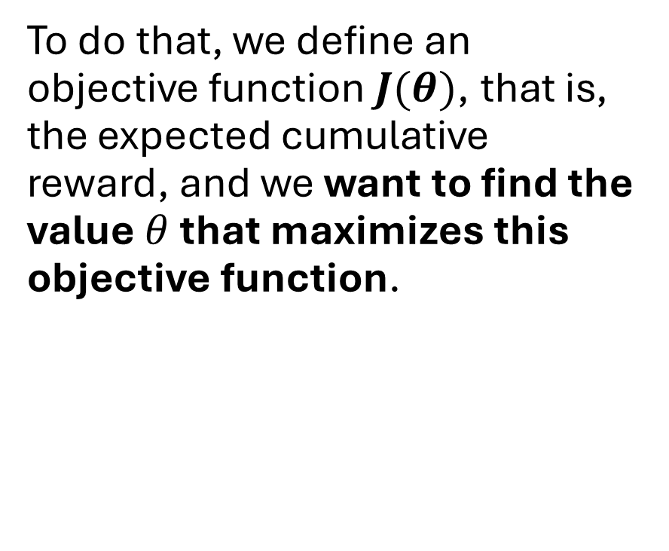
Policy-based methods
To do that, we define an objective function$J(θ)$, that is, the expected cumulative reward, and we want to find the value $θ$ that maximizes this objective function.

Slide 14
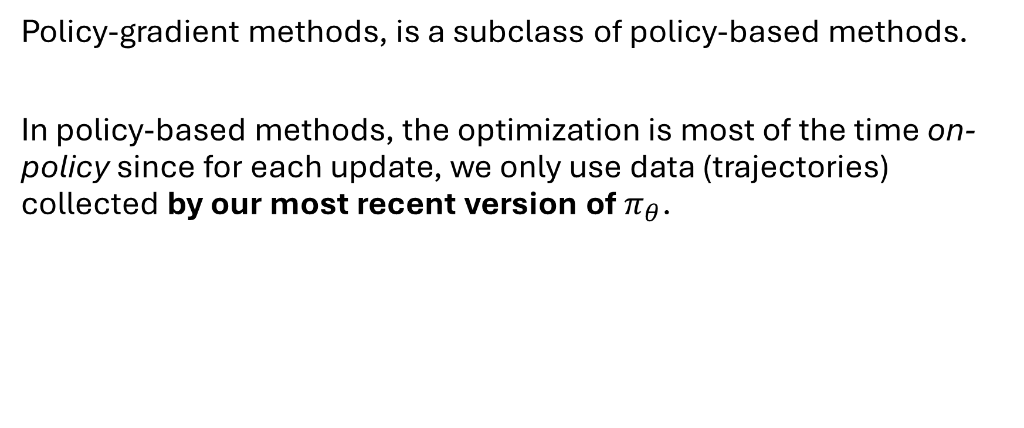
Policy-gradient methods
Policy-gradient methods, is a subclass of policy-based methods.
In policy-based methods, the optimization is most of the time on-policy since for each update, we only use data (trajectories) collected by our most recent version of $π_{θ}$.

Slide 15
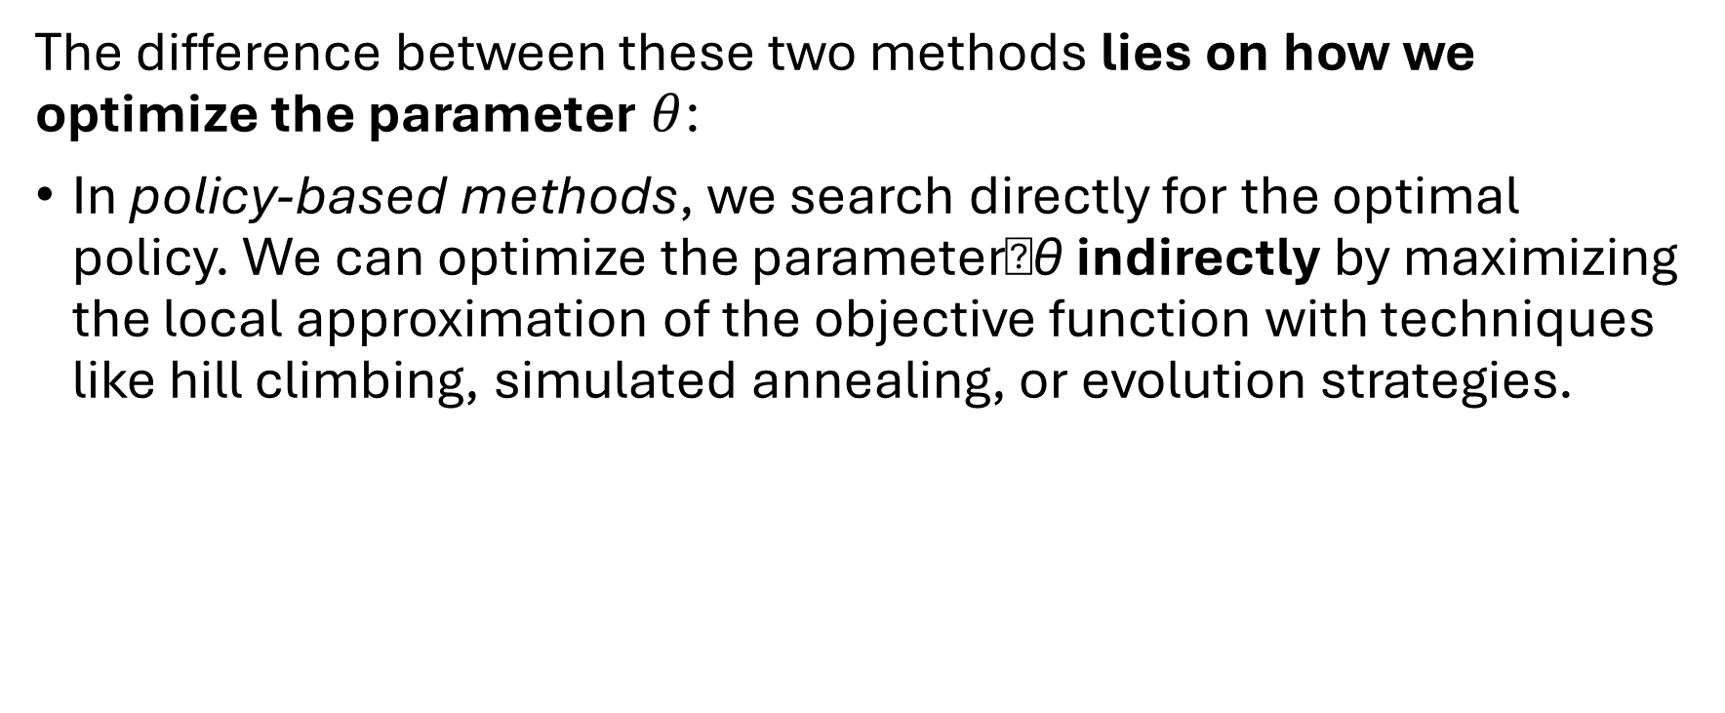
Policy-based and Policy-gradient methods
The difference between these two methods lies on how we optimize the parameter $θ$:
In policy-based methods, we search directly for the optimal policy. We can optimize the parameter�θ indirectly by maximizing the local approximation of the objective function with techniques like hill climbing, simulated annealing, or evolution strategies.

Slide 16
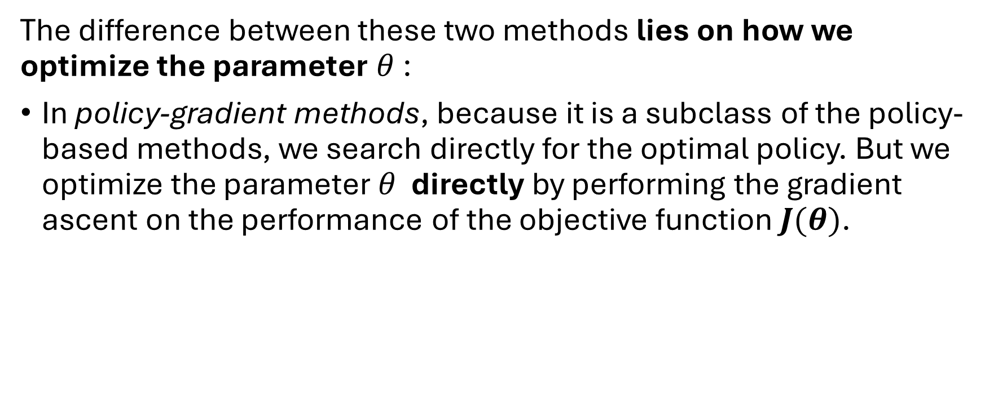
Policy-based and Policy-gradient methods
The difference between these two methods lies on how we optimize the parameter $θ$:
In policy-gradient methods, because it is a subclass of the policy-based methods, we search directly for the optimal policy. But we optimize the parameter $θ$ directly by performing the gradient ascent on the performance of the objective function $J(θ)$.

Slide 17
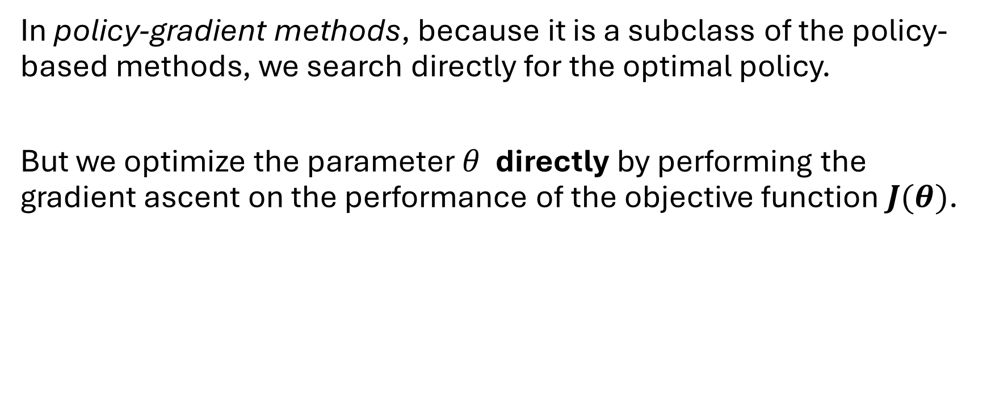
Policy-gradient methods
In policy-gradient methods, because it is a subclass of the policy-based methods, we search directly for the optimal policy.
But we optimize the parameter $θ$ directly by performing the gradient ascent on the performance of the objective function $J(θ)$.

Slide 18
Policy Gradient Methods
Policy Gradient Methods are a class of reinforcement learning algorithms that directly optimize the policy (the mapping from states to actions) by adjusting its parameters to maximize expected reward, rather than learning a value function and deriving the policy from it (as in value-based methods like Q-learning).

Slide 19
Policy Gradient Methods
Value-based methods (like Q-learning, DQN) struggle with:
Continuous or high-dimensional action spaces.
Stochastic policies.
Policy gradient methods learn a parameterized policy πθ(a∣s)\pi_\theta(a|s)πθ​(a∣s) directly.
The goal:

Slide 20
Policy Gradient Methods
At this point, you might ask, “but Deep Q-Learning is excellent! Why use policy-gradient methods?“
To answer this question, let’s study the advantages and disadvantages of policy-gradient methods.

Slide 21
The advantages and disadvantages of policy-gradient methods
We can estimate the policy directly without storing additional data (action values).

Slide 22
Advantages of policy gradient methods
Policy-gradient methods can learn a stochastic policy while value functions can’t.
Policy-gradient methods are more effective in high-dimensional action spaces and continuous actions spaces
Policy-gradient methods have better convergence properties

Slide 23
Disadvantages of policy gradient methods
Frequently, policy-gradient methods converges to a local maximum instead of a global optimum.
Policy-gradient goes slower, step by step: it can take longer to train (inefficient).
Policy-gradient can have high variance. We’ll see in the actor-critic unit why, and how we can solve this problem.

Slide 24
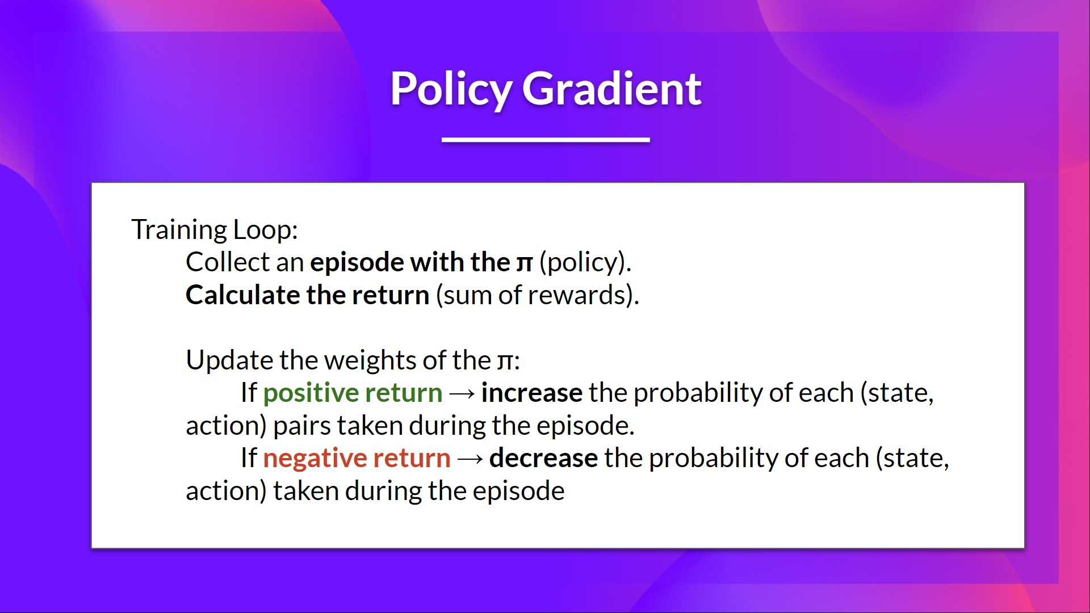

Slide 25
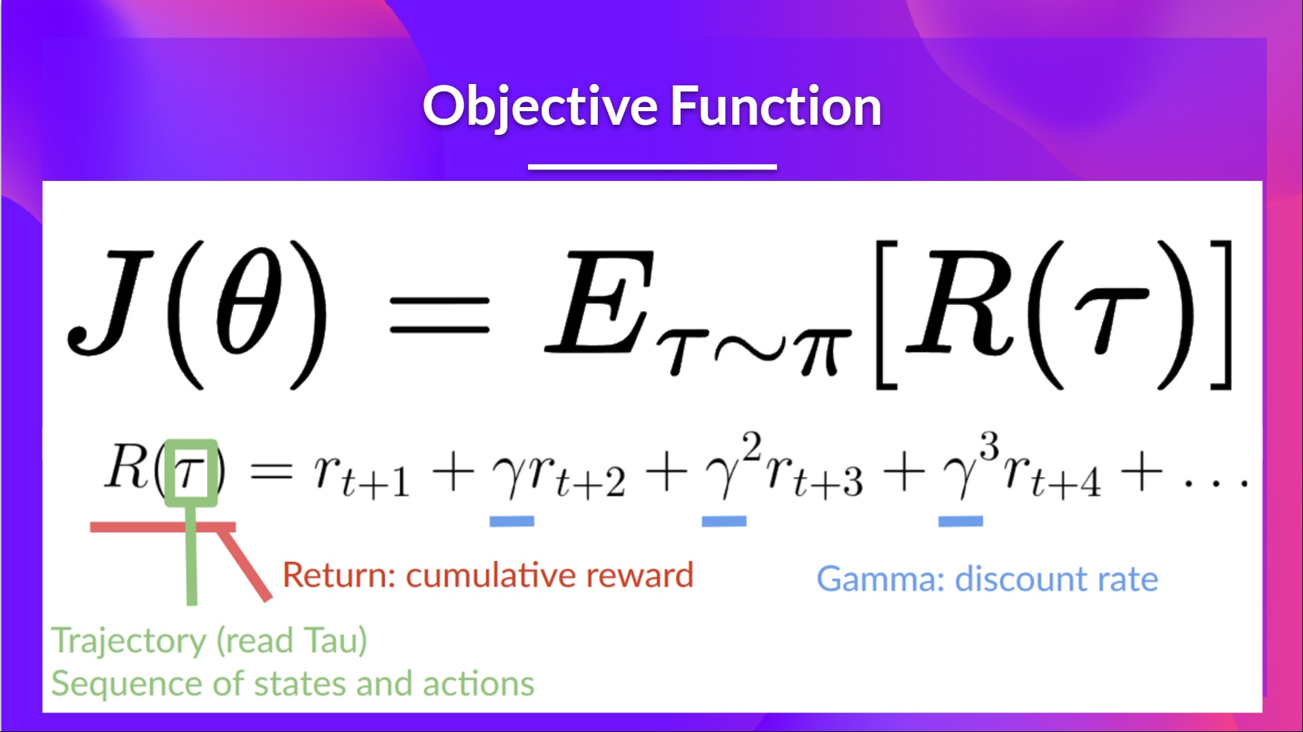

Slide 26
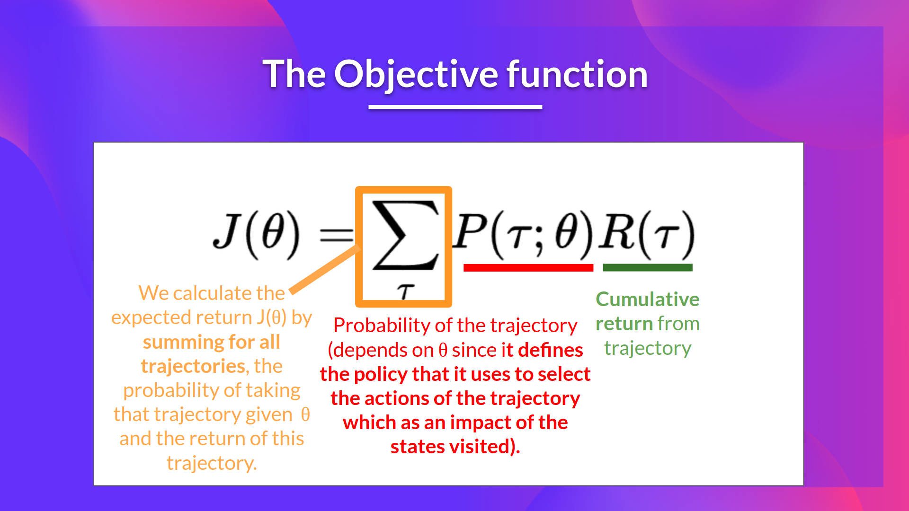

Slide 27
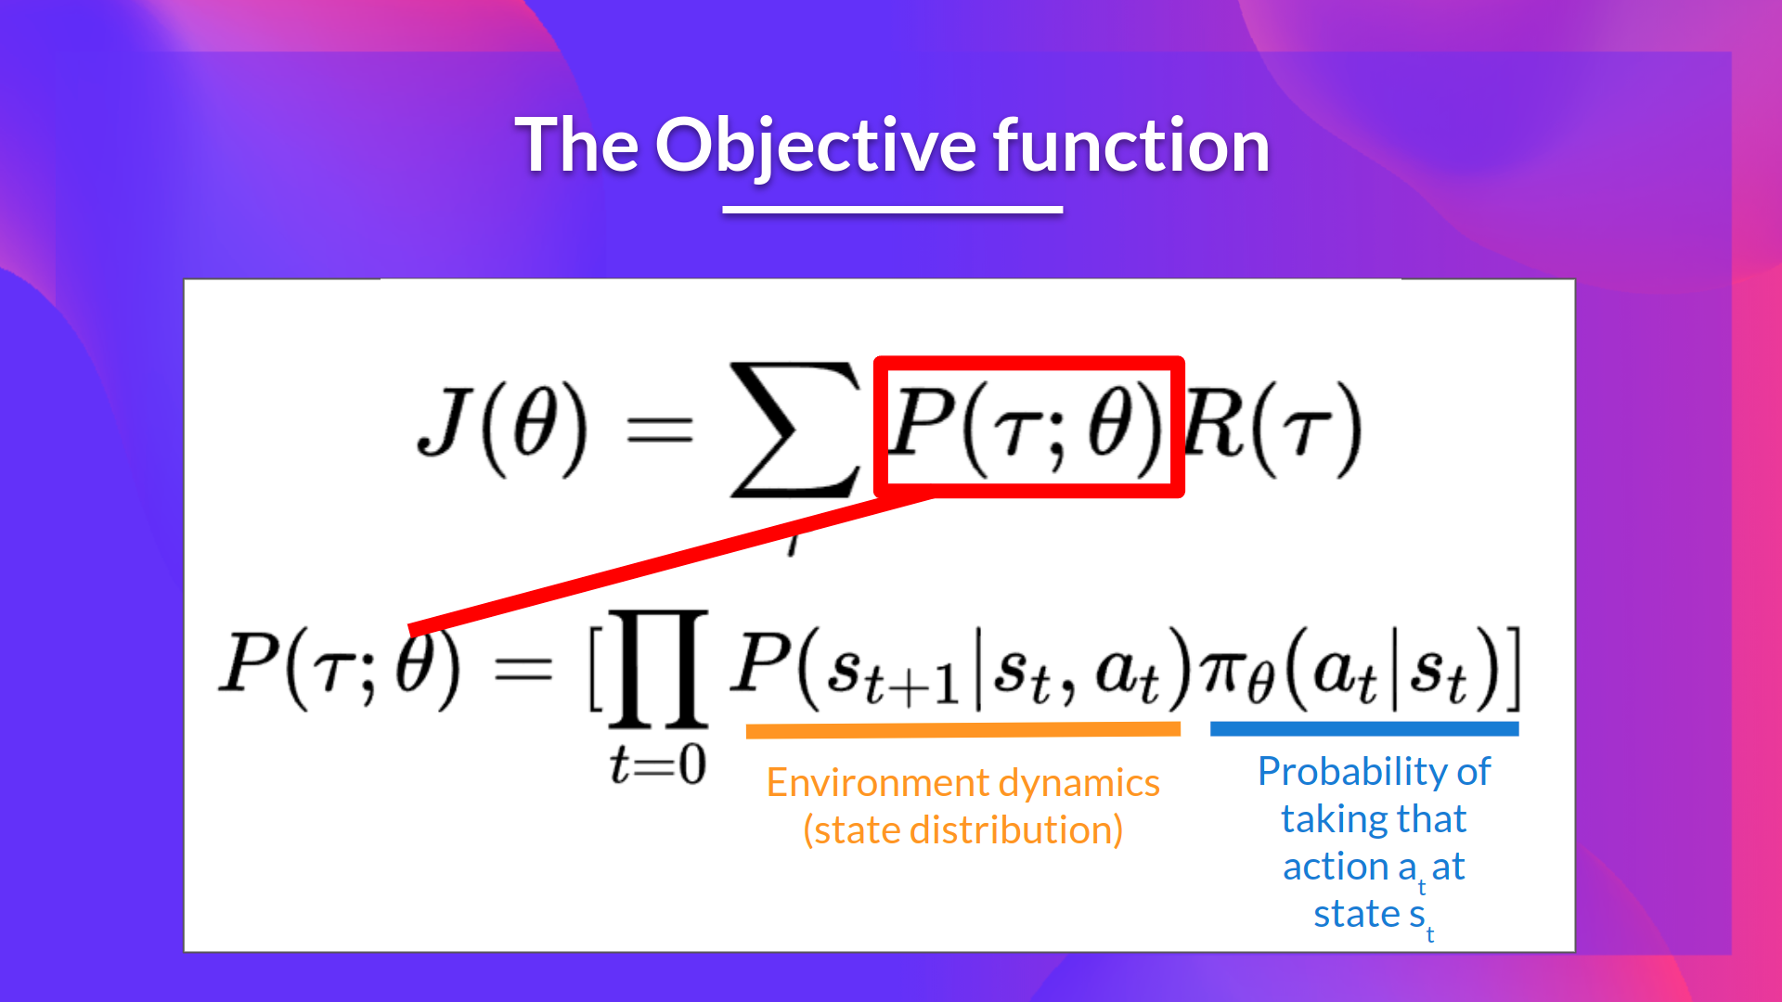

Slide 28
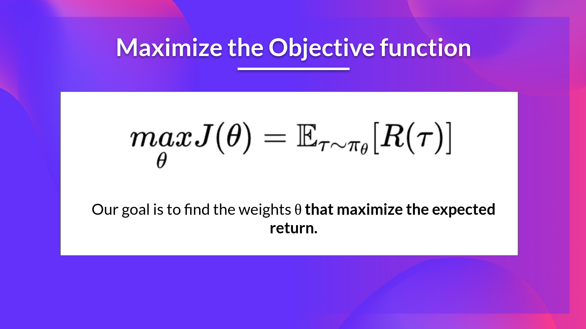

Slide 29
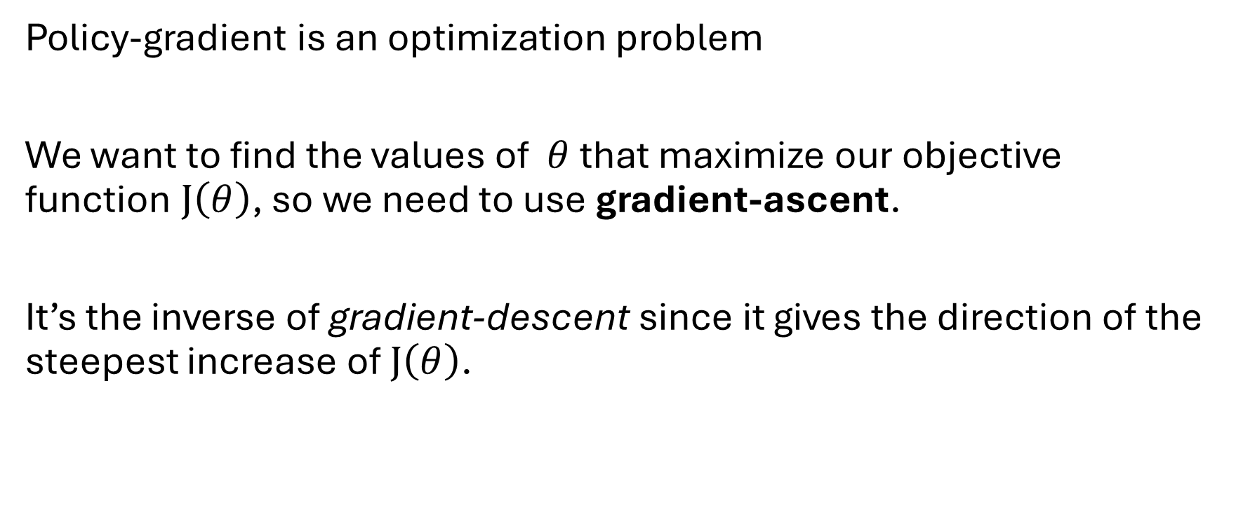
Policy Gradient Method
Policy-gradient is an optimization problem
We want to find the values of $θ$that maximize our objective function $J\left(θ\right)$, so we need to use gradient-ascent.
It’s the inverse of gradient-descent since it gives the direction of the steepest increase of $J\left(θ\right)$.

Slide 30
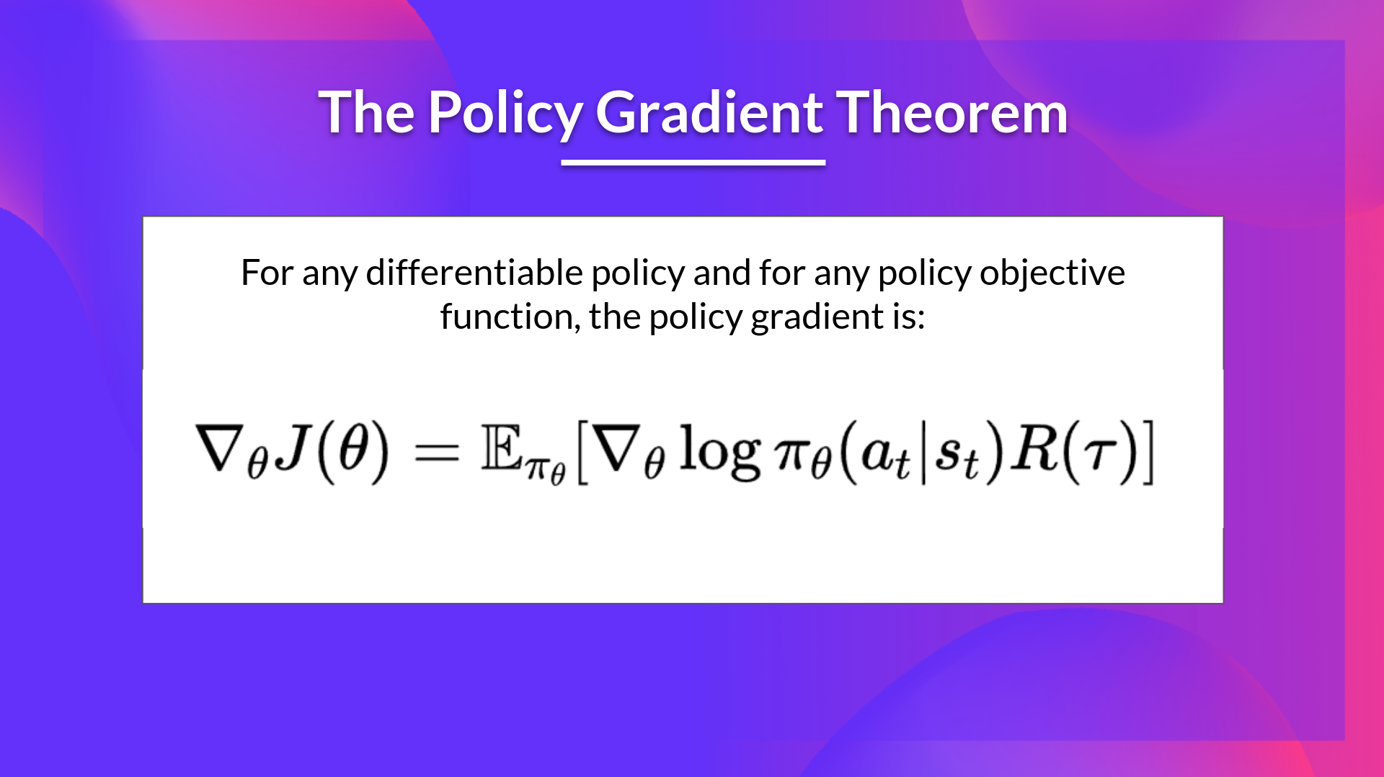
The Policy Gradient Theorem
The gradient of the expected return can be written as:
The gradient of the expected return can be written as:
This key result tells us how to change the policy parameters to increase performance:
If an action leads to high return, increase its probability.
If it leads to low return, decrease its probability.

Slide 31

REINFORCE
Also called Monte-Carlo policy-gradient
Is a policy-gradient algorithm that uses an estimated return from an entire episode to update the policy parameter $θ$:

Slide 32
REINFORCE
Step 1: Collect Episodes
The agent interacts with the environment for a fixed number of steps or until an episode is complete, following the current policy. This generates a trajectory consisting of states, actions and rewards.

Slide 33
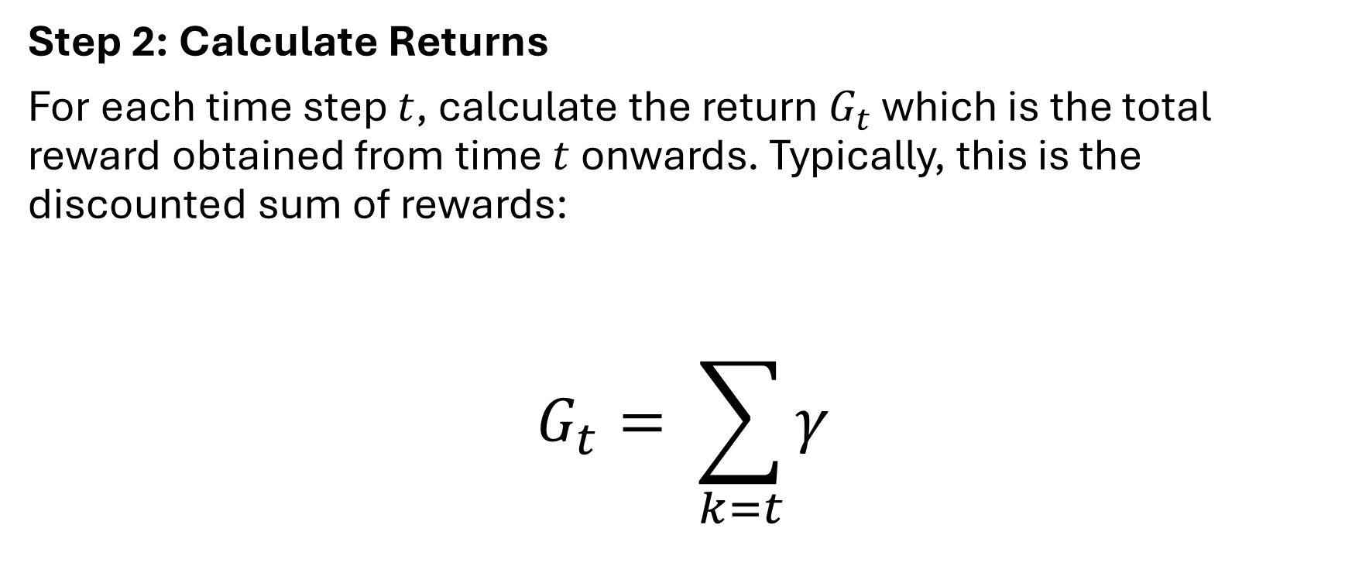
REINFORCE
Step 2: Calculate Returns
For each time step $t$, calculate the return $G_{t}$​​ which is the total reward obtained from time $t$onwards. Typically, this is the discounted sum of rewards:

Slide 34
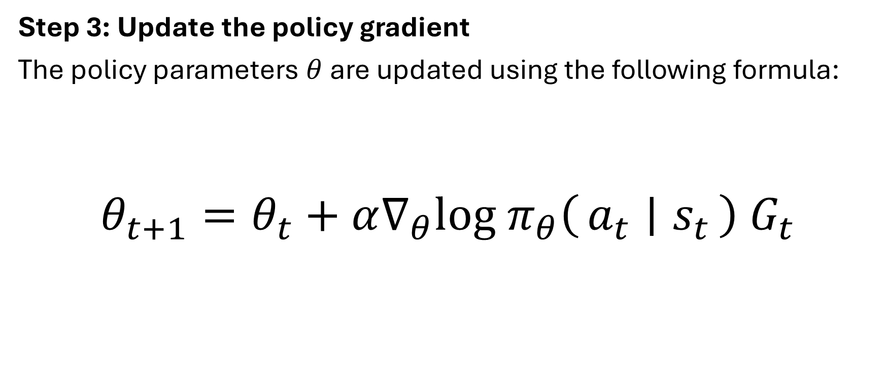
REINFORCE
Step 3: Update the policy gradient
The policy parameters $θ$ are updated using the following formula:
$$θ_{t+1}​=θ_{t}​+α∇_{θ}log π_{θ}​\left(a_{t}​ ∣ s_{t}​\right){ G}_{t}​$$

Slide 35
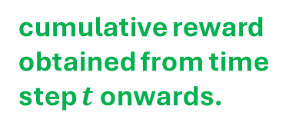
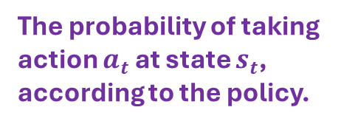
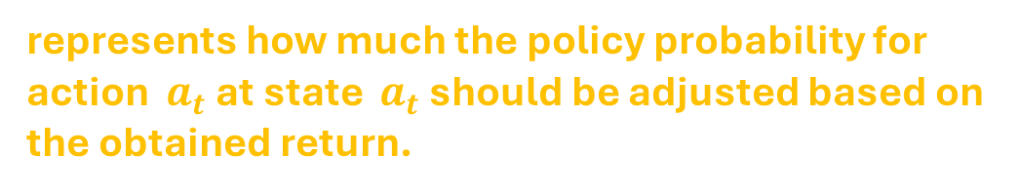
REINFORCE Policy Gradient Update
$$θ_{t+1}​=θ_{t}​+α∇_{θ}log π_{θ}​\left(a_{t}​ ∣ s_{t}​\right){ G}_{t}​$$
Learning rate
The probability of taking action $a_{t}​$​​ at state $s_{t}​$​, according to the policy.
cumulative reward obtained from time step $t$ onwards.
represents how much the policy probability for action $a_{t}$ at state $a_{t}$​ should be adjusted based on the obtained return.

Slide 36
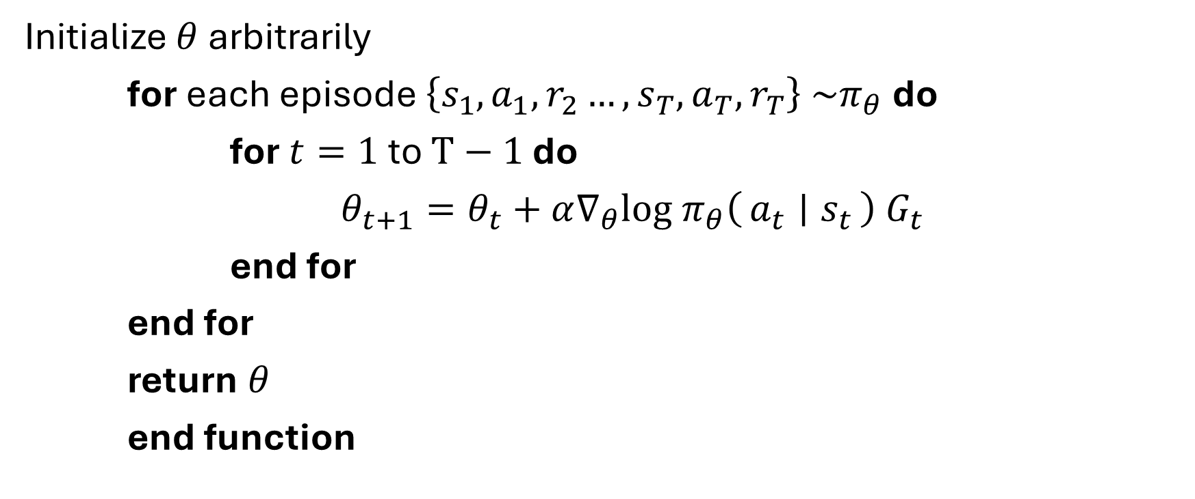
REINFORCE Algorithm
Initialize $θ$ arbitrarily
for each episode $\left\{s_{1},a_{1},r_{2}…,s_{T},a_{T},r_{T}\right\} \sim π_{θ}$ do
for $t=1$ to $T−1$ do
$θ_{t+1}​=θ_{t}​+α∇_{θ}log π_{θ}​\left(a_{t}​ ∣ s_{t}​\right){ G}_{t}​$
end for
end for
return $θ$
end function

Slide 37
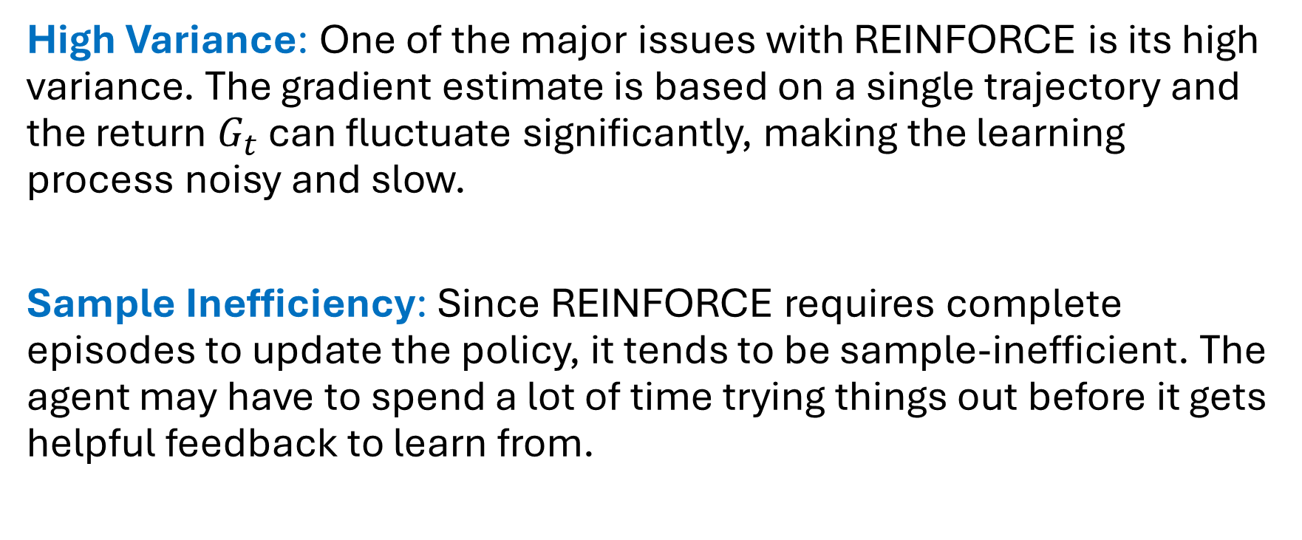
Limitations of REINFORCE
High Variance: One of the major issues with REINFORCE is its high variance. The gradient estimate is based on a single trajectory and the return $G_{t}$​​ can fluctuate significantly, making the learning process noisy and slow.
Sample Inefficiency: Since REINFORCE requires complete episodes to update the policy, it tends to be sample-inefficient. The agent may have to spend a lot of time trying things out before it gets helpful feedback to learn from.

Slide 38
Limitations of REINFORCE
Convergence Issues: Because the results can be very random and learning is slow REINFORCE needs a lot of practice before it learns a good way to act.

Slide 39
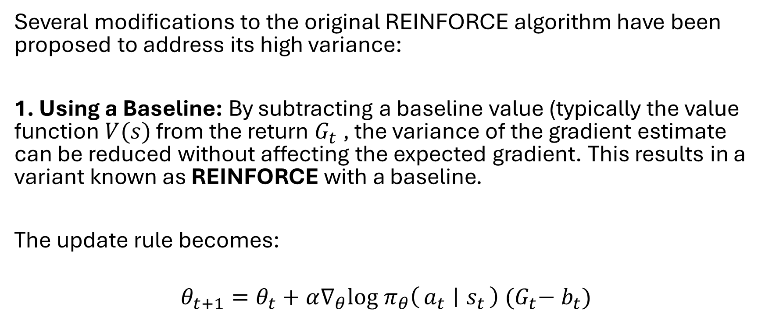
Variants of REINFORCE
Several modifications to the original REINFORCE algorithm have been proposed to address its high variance:
1. Using a Baseline: By subtracting a baseline value (typically the value function $V(s)$ from the return $G_{t}$​​, the variance of the gradient estimate can be reduced without affecting the expected gradient. This results in a variant known as REINFORCE with a baseline.
The update rule becomes:
$$θ_{t+1}​=θ_{t}​+α∇_{θ}log π_{θ}​\left(a_{t}​ ∣ s_{t}​\right){ (G}_{t}​−{ b}_{t})$$

Slide 40
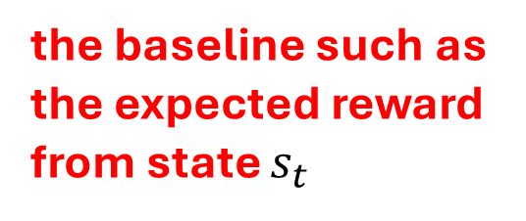

Variants of REINFORCE
$$θ_{t+1}​=θ_{t}​+α∇_{θ}log π_{θ}​\left(a_{t}​ ∣ s_{t}​\right){ (G}_{t}​−{ b}_{t})$$
the baseline such as the expected reward from state $s_{t}$

Slide 41
Variants of REINFORCE
Several modifications to the original REINFORCE algorithm have been proposed to address its high variance:
2. Actor-Critic: It is a method that use two parts to learn better: the actor and the critic.
The actor chooses what action to take while the critic checks how good that action was and give feedback.
This helps to make learning more stable and faster by reducing random mistakes.

Slide 42
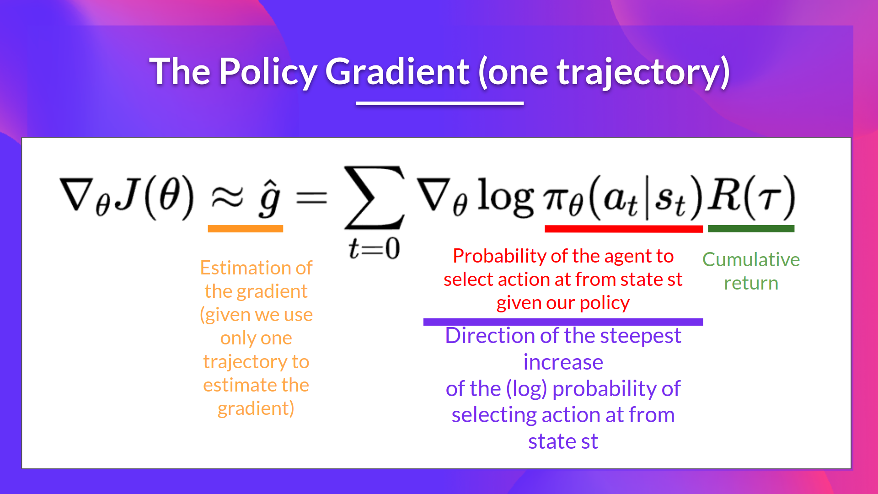

Slide 43
